Slide 1

Detect Persons and Zebra-Crossing in Real time video feed from Vehicles
By
Vishal Shivakumar Kanakamamidi
2nd year
Course - B.tech CSE
IIIT Kottayam

Slide 2
Abstract
In this report , we are going to discuss ,
Why is detection of persons and crosswalk (Zebra-crossing) important and how it can reduce accidents
Architectural Specifications
Experimental Result Analysis

Slide 3
Introduction
The Indian government has released the official statistics for road accidents, injuries and fatalities for the year 2017, and the news continues to be bad. As per the latest data, in 2017, a total of 4,64,910 road accidents were reported in the country, claiming 1,47,913 lives and causing injuries to 4,70,975 persons, which translates into 405 deaths and 1,290 injuries each day from 1,274 accidents. This also means that 16 people are killed and another 53 are injured every hour on Indian roads. Considering that these are the officially reported accidents, there must be a fair number that go unreported across the length and breadth of India.
So the main purpose of this project is to reduce those accidents by making a mobile app which can alert the driver and also apply emergency brakes when there is a person on the road and also slow down the Vehicle when zebra crossing approaches

Slide 4
Objectives
Objectives of project are,
To detect persons who are closer to the vehicle and also detect crosswalks(Zebra – crossing) ,using Transfer Learning.
Getting an optimal model for training through transfer learning so as to get the real time classification of persons and crosswalk in a low specifications devices , such as smart phone.
Training the model on the collected database of images
Finally implementing the model to android application for real time classification.

Slide 5
Architectural Specifications
Architectural Specifications,
I have used Python 3.6 for training of the model .
The network model which we have used is Mobilenet V1.
The reason for choosing this neural network model is,
It is very much faster in classification than other network models such as Resnet, Alexnet etc .
As the name suggests , it is specially made for using neural networks in Mobile Devices
Accuracy is near to 90 % .
The big idea behind MobileNet V1 is that convolutional layers, which are essential to computer vision tasks but are quite expensive to compute, can be replaced by so-called depthwise separable convolutions due to which it is faster than other neural network models.
I have trained the model with 1200 images for 11 hours in my laptop(without GPU) for 20000 steps.

Slide 6
Architectural Specifications
The full MobileNets network has 30 layers. The design of the network is quite straightforward,
convolutional layer with stride 2
depthwise layer
pointwise layer that doubles the number of channels
depthwise layer with stride 2
pointwise layer that doubles the number of channels
depthwise layer
pointwise layer
depthwise layer with stride 2
pointwise layer that doubles the number of channels
And so on ...

Slide 7
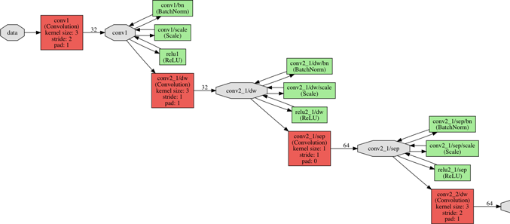
MobileNet architecture

Slide 8
Experimental Setup
Till now I have not made an android app but I have made the trained model which is the most important part.
For experimenting we took a video and used our model for classification in laptop .
3 videos were taken from which one of the video is taken near our campus .
The Videos were taken from the dashboard of the car in other two videos.
The images of the experiment are shown in the further slides.

Slide 9
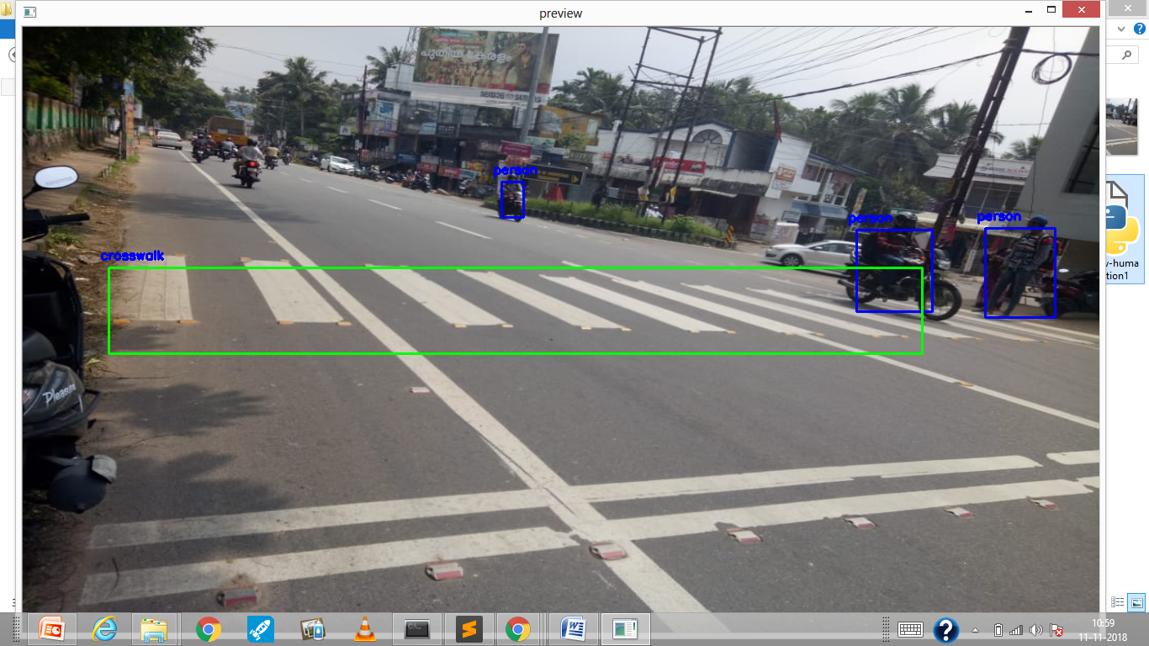
Image from Video 1
Place your screenshot here
In the image the blue box is Person and green box is crosswalk(zebra-crossing)

Slide 10
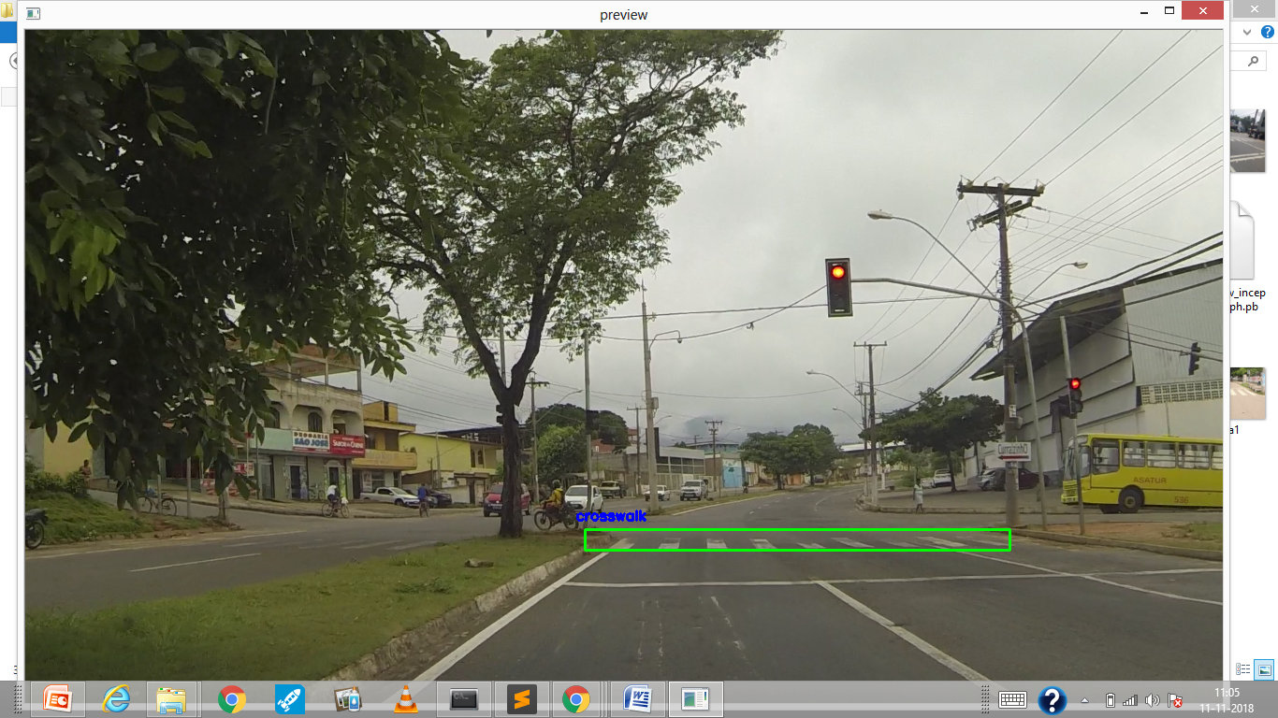
Image from Video 2
Place your screenshot here
In the image the blue box is Person and green box is crosswalk(zebra-crossing)

Slide 11
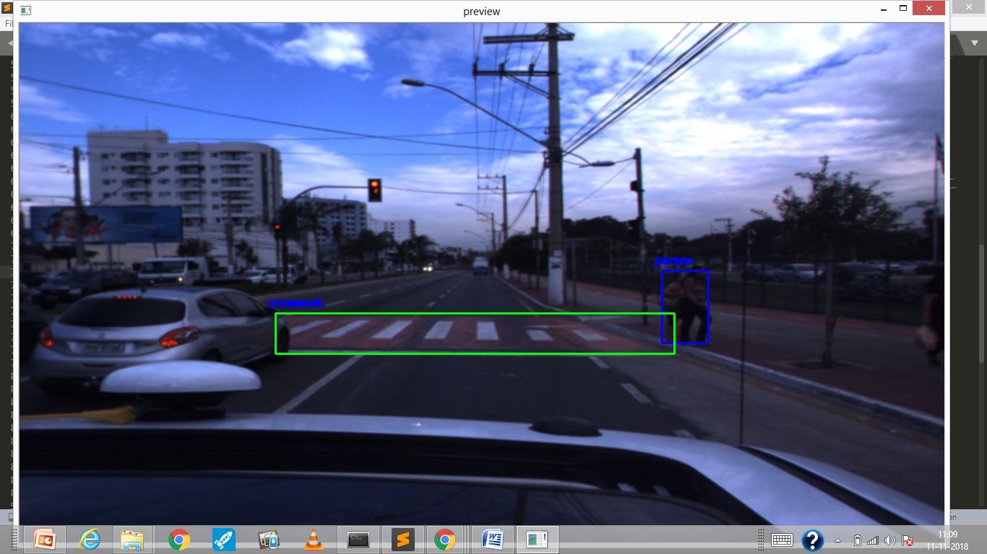
Image from Video 3.1
Place your screenshot here
In the image the blue box is Person and green box is crosswalk(zebra-crossing)

Slide 12
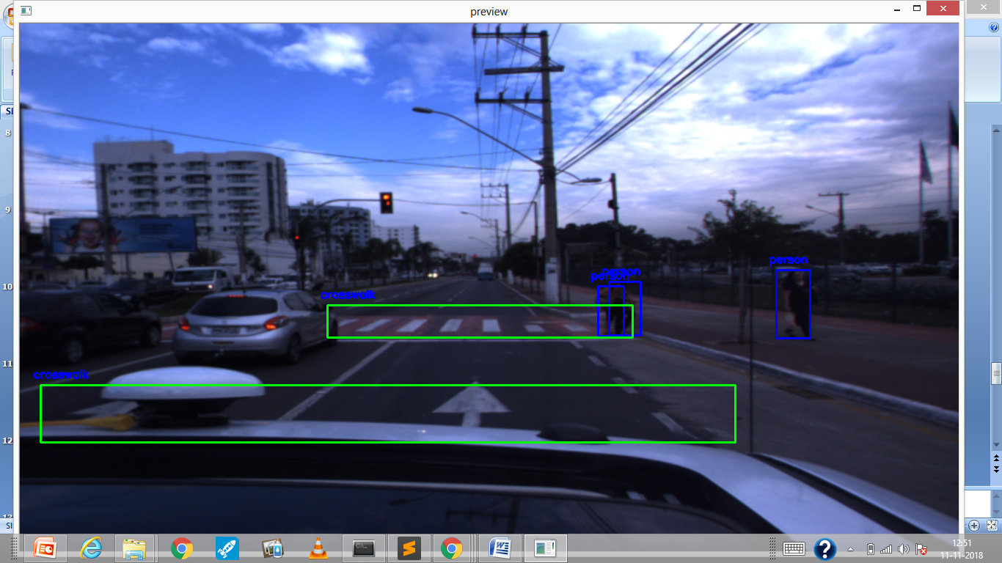
Image from Video 3.2
Place your screenshot here
In the image the blue box is Person and green box is crosswalk(zebra-crossing)

Slide 13
Experimental Analysis
I was successful in classifying persons and crosswalks .
The video output was shown with 10 fps(frames per second).
All the crosswalks are detected but sometimes it also detects other things on the road such as arrows on the road.
To recover this problem we are going to train it on more 3040 images to recover this problem.
It is compatible for Indian roads as most of them are plain(with no signs).
There is no such problem in person detection.

Slide 14
Conclusion
This application is successfully detecting persons and crosswalks in the Video feed and also in the real time videos.
I am going to further work on this app for making it capable to detect lane , Vehicles , Traffic signals , Sign boards etc.
This type of system is only present in costly vehicles , so the aim of our team is to make it available for all types of vehicles for very less money by launching it on android as many people have android phones in India and thereby reducing accidents which takes place in India.

Slide 15
References
Information about Accidents in India –
https://www.autocarindia.com/industry/road-accidents-in-india-claim-more-than-14-lakh-lives-in-2017-410111
Information about Mobilenet –
http://machinethink.net/blog/googles-mobile-net-architecture-on-iphone/

Slide 16
Thank you

